Slide 1
Beyond CS Bridge

Slide 2
Plan For Today
Where We’ve Been
Where We Can Go Next
Learning Resources
Python
Thank you!

Slide 3
Plan For Today
Where We’ve Been
Where We Can Go Next
Learning Resources
Python
Thank you!

Slide 4
Quick Recap
Karel
Control Flow
Variables
Control Flow Revisited
Graphics
Functions
Nested Loops
Animation
Lists
Mouse
Breakout
Keyboard
Dictionaries
Artificial Intelligence
Interactors
Notes:
Nick

Slide 5
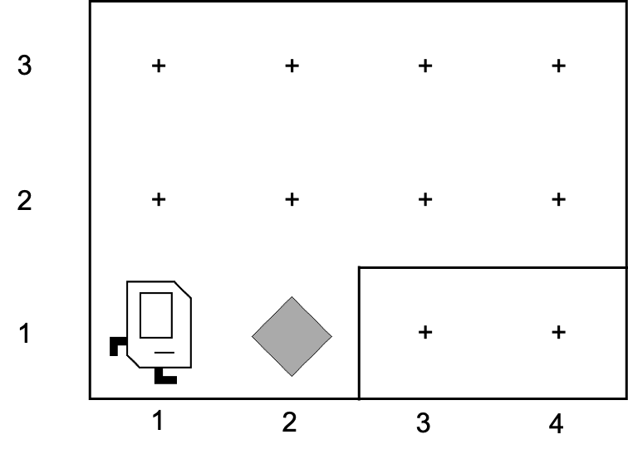
First Day

Slide 6
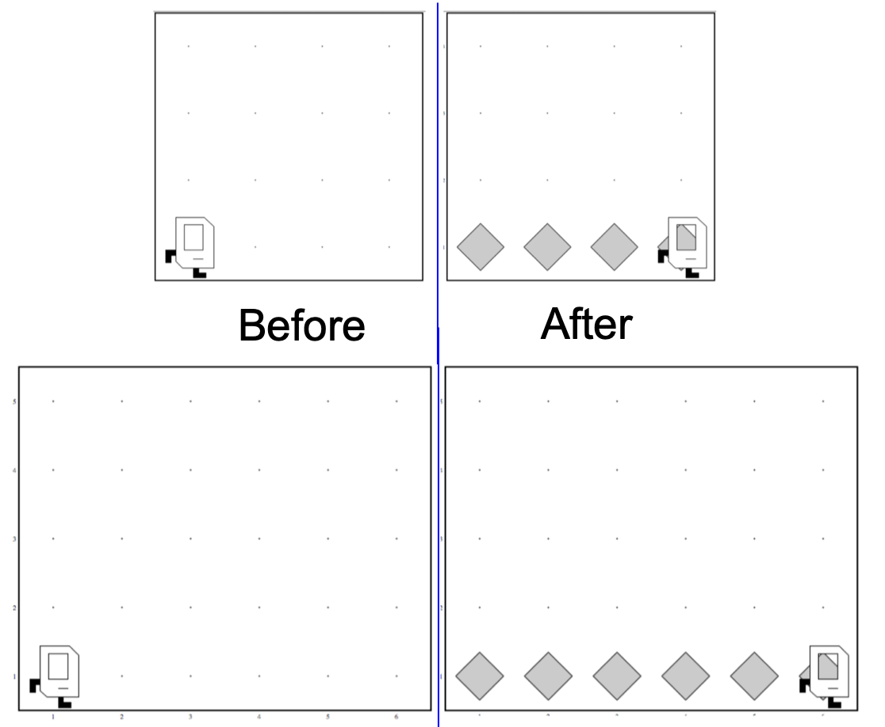
Generalization

Slide 7

Variables

Slide 8
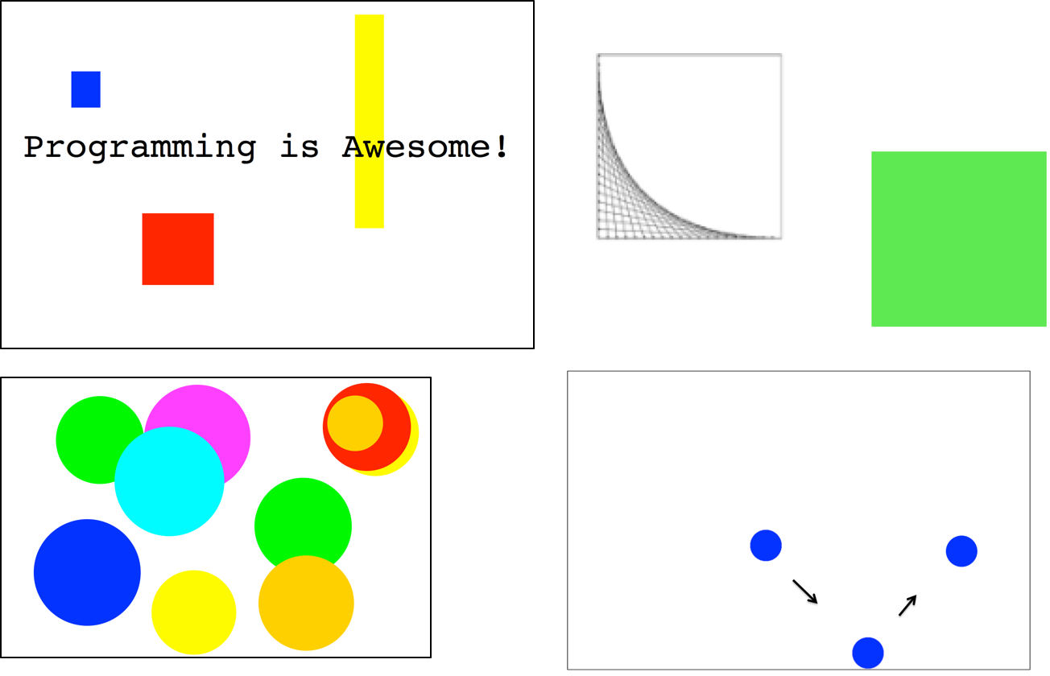

Graphics

Slide 9
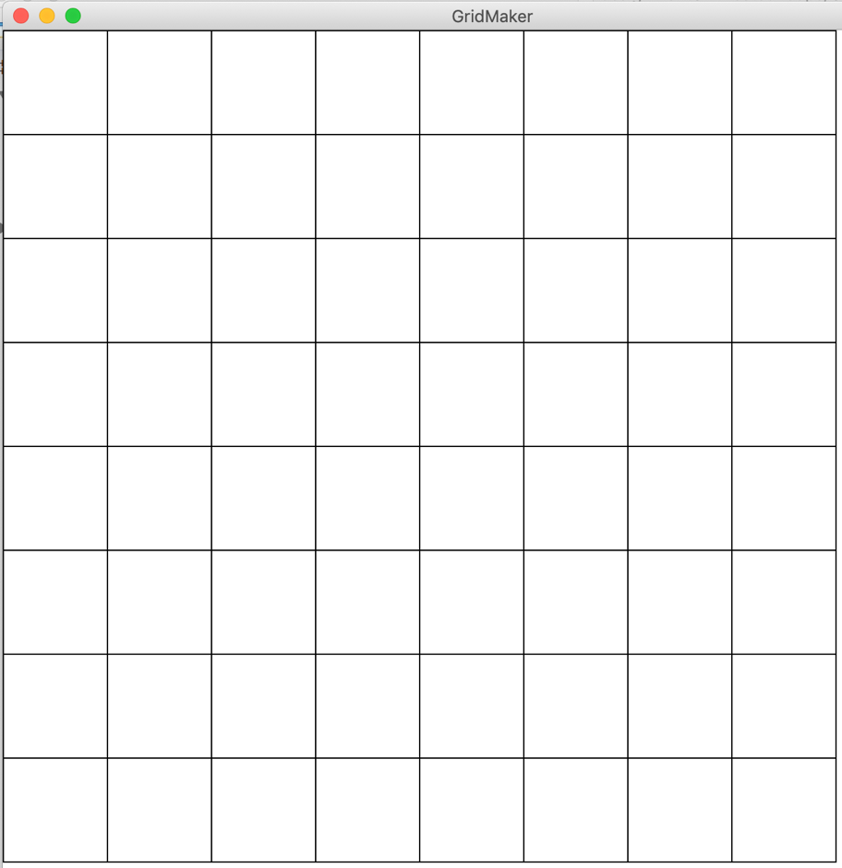
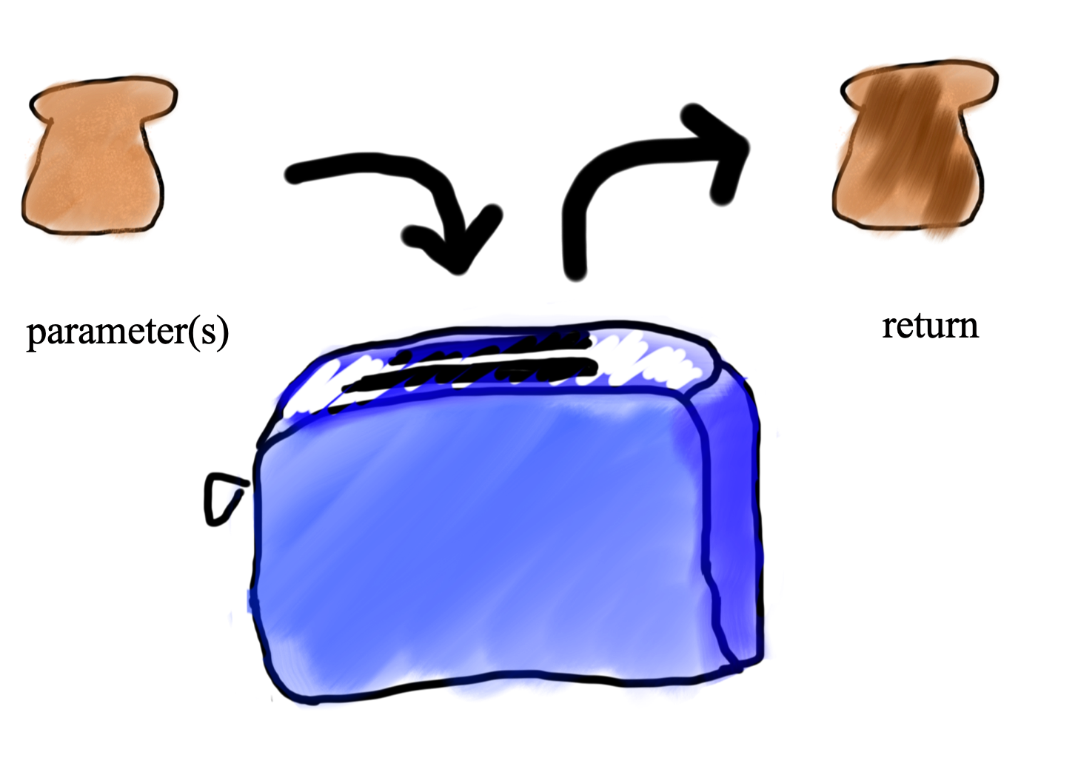
Functions and Advanced Loops

Slide 10
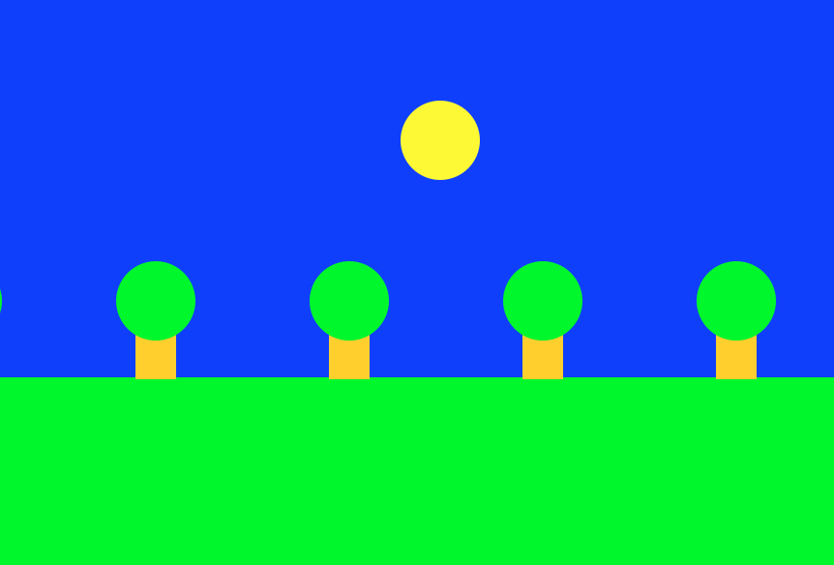
Animation

Slide 11

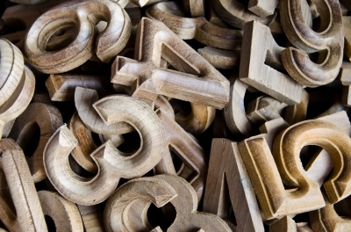
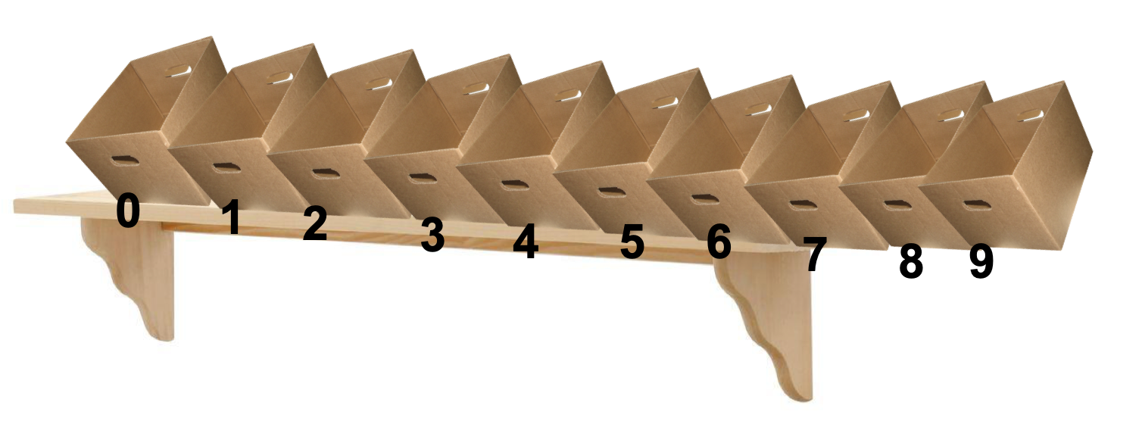
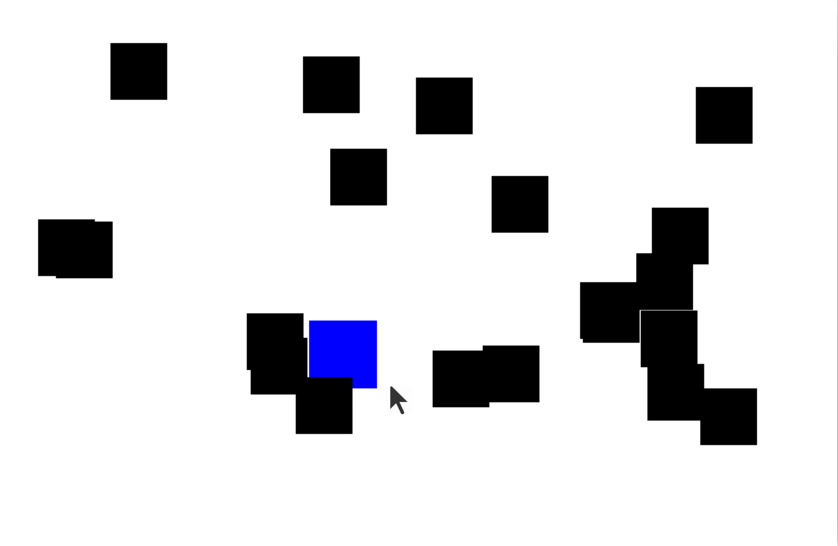
Lists and The Mouse

Slide 12
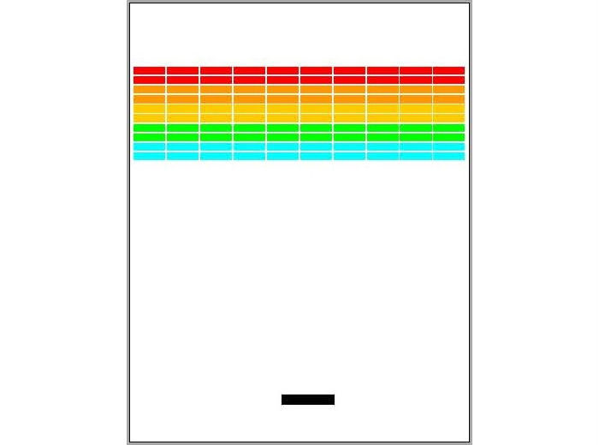
Breakout

Slide 13
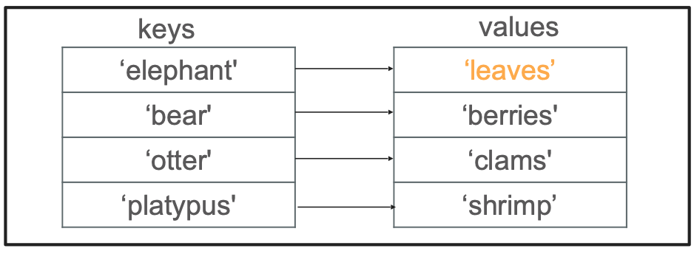
Dictionaries

Slide 14
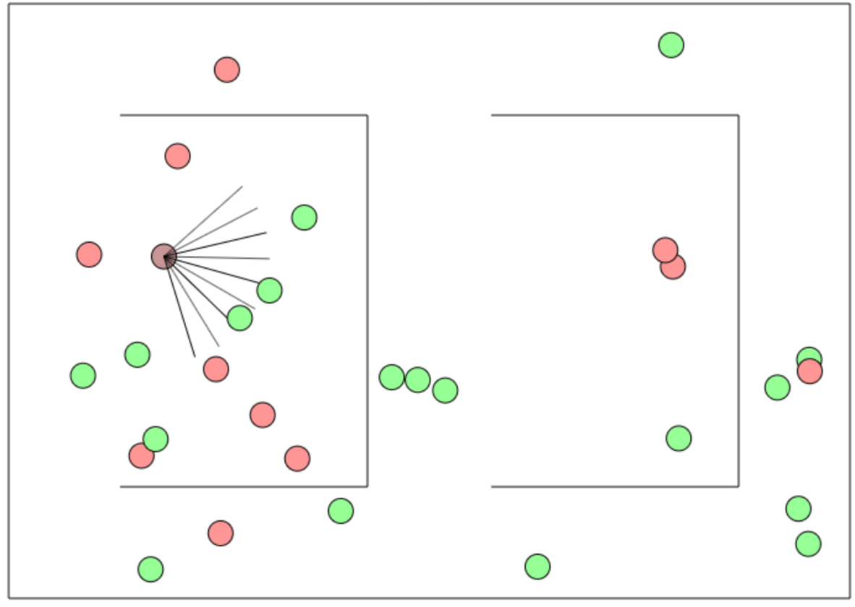
AI

Slide 15
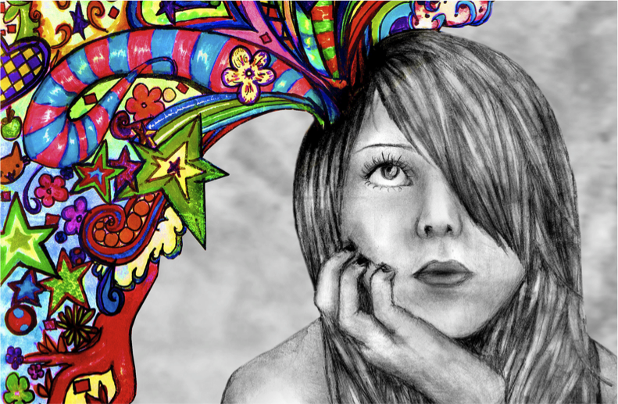
Final Project

Slide 16
Plan For Today
Where We’ve Been
Where We Can Go Next
Learning Resources
Python
Thank you!

Slide 17
Self-study
https://see.stanford.edu/Course/CS106A (Java)
https://web.stanford.edu/class/archive/cs/cs106a/cs106a.1206/ (Python)
https://online.stanford.edu
https://coursera.org
https://khanacademy.org
https://pluralsight.com
https://docs.python.org/3/
https://online.csbridge.org
Notes:
Eliska + Ondra

Slide 18
Useful download links
https://www.jetbrains.com/pycharm/
Notes:
Eliska + Ondra

Slide 20
Demo: Creating a new Python program and installing a Python package

Slide 21
Stay in touch!
https://us.edstem.org/courses/968/discussion/
Notes:
Eliska + Ondra

Slide 22
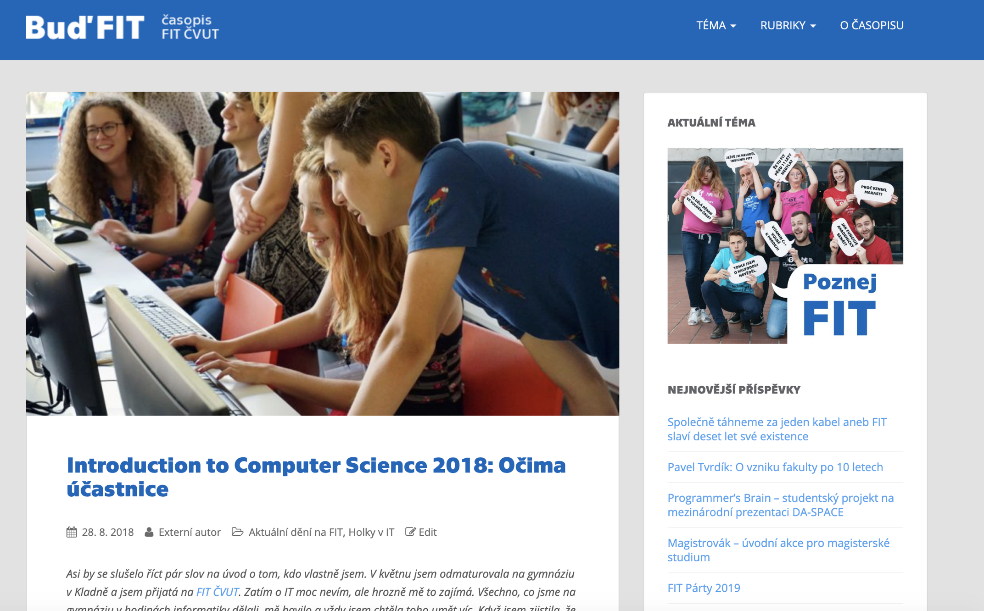

Be a star!
https://casopis.fit.cvut.cz/deni-na-fit/introduction-to-computer-science-2018-ocima-ucastnice/
Notes:
Eli

Slide 23
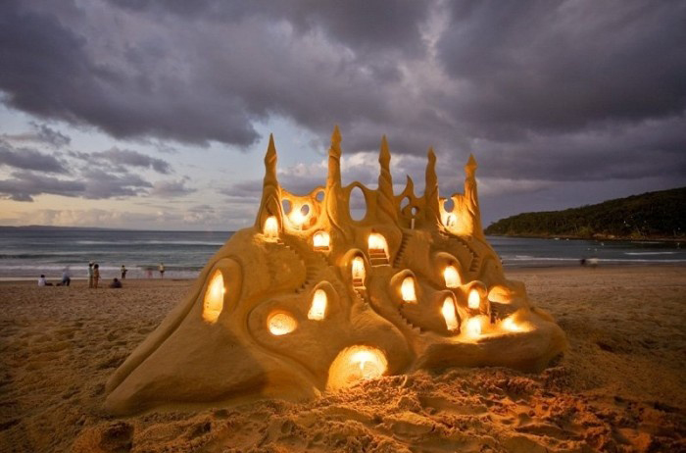
Joy of Building

Slide 24
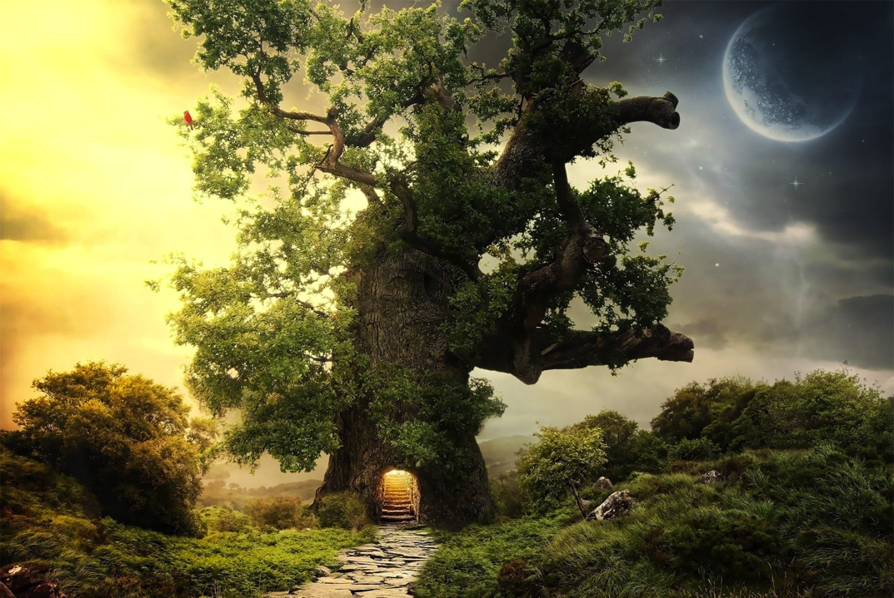
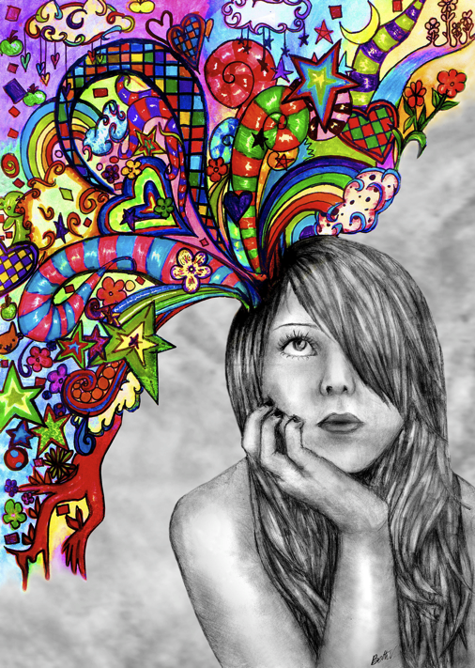
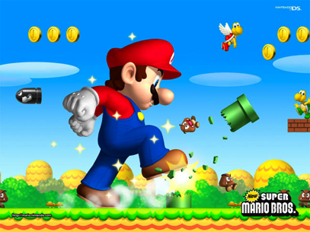

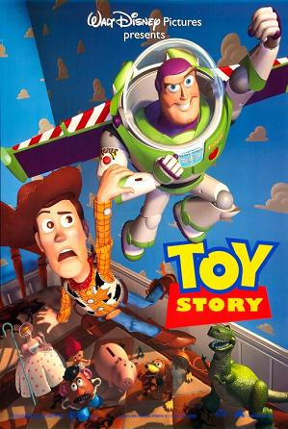
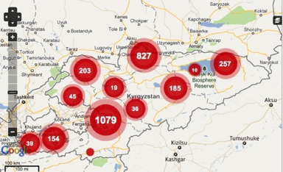
Notes:
Super Mario: Japan
Angry Birds: Finland
Pixar: USA
Ushahidi: Kenya

Slide 25

Closest Thing to Magic

Slide 26
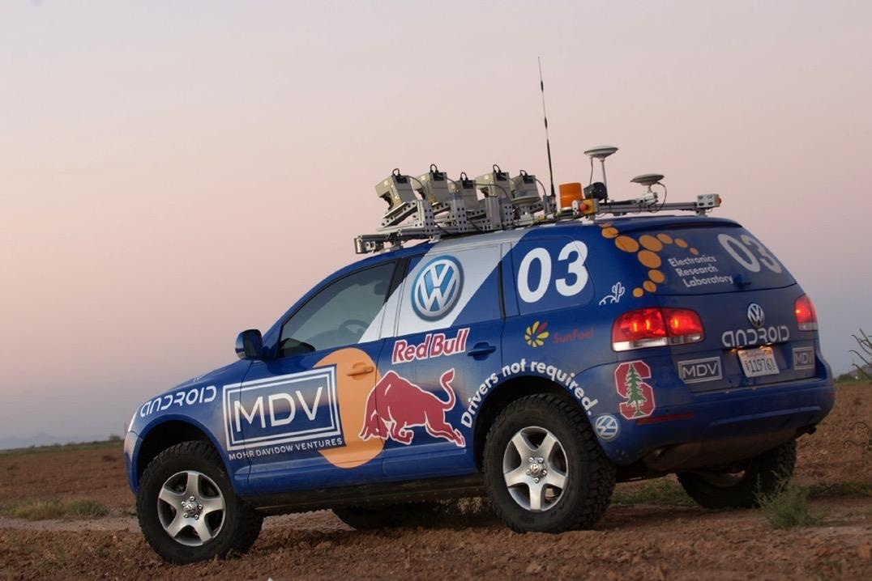
Now is the time!

Slide 27
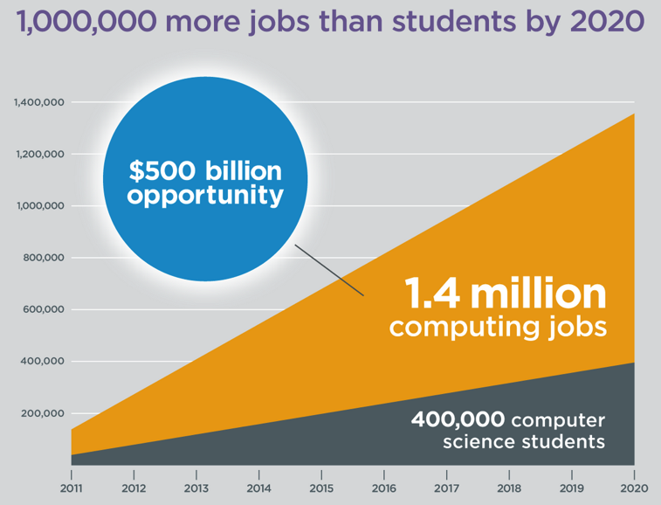
Oh and it’s useful
Code.org

Slide 28
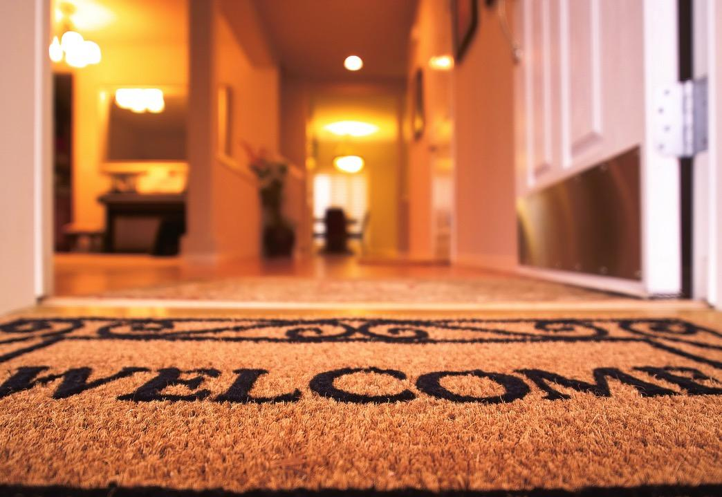
Everyone is welcome
Tell your friends :-)

Slide 29
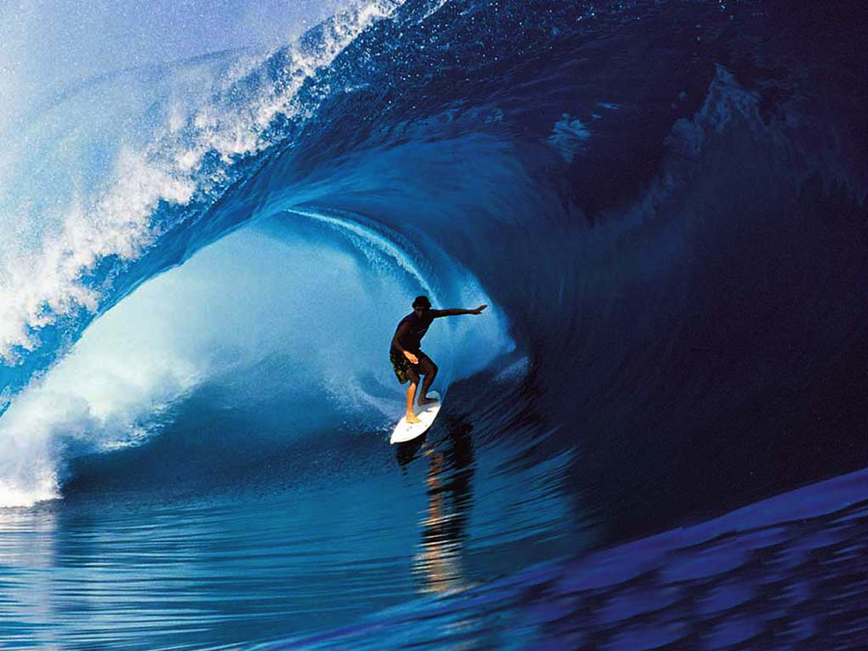

Keep Learning by Doing
# good life
while True:
learn()
play()
love()
time.sleep(8)

Slide 30
We hope we excited you about learning more computer science!
Notes:
Not nearly enough adults in the world are able to do what you have now demonstrated!

Slide 31
You should be proud of yourselves
Notes:
Not nearly enough adults in the world are able to do what you have now demonstrated!

